Slide 1
Moonshot openings & Business moves Newsletter
Mid June update
Summary
Full recently announced openings
Changes of ownership / Restructures / Acquisitions

Slide 2
Executive Summary for Moonshot Hospitality Industry Updates - Mid June 2024
Recent Openings and Growth Strategies
Simmons Bars has secured The Botanist site in Manchester for a national rollout starting this September. This move is a strategic expansion outside London, positioning Simmons Bars among notable operators like Be At One and Wetherspoons in Manchester. The venue will leverage a late license and extensive space, enhancing its market presence​​.
Banana Tree by The Big Table Group has shown consistent strong sales and signed two new site leases, alongside several conversions. This expansion aligns with their strategy to grow Banana Tree to the scale of their Las Iguanas brand within two years​​.
Gail’s Bakery is set to open in Liverpool Street station, marking the start of a travel hub-focused expansion strategy. The new express format aims to capture high-volume, high-speed customer segments​​.
Wagamama continues its growth with a new restaurant opening in Walton-on-Thames, enhancing its footprint to 166 UK sites. The launch includes their latest summer menu, aligning with their strategy to continuously innovate and attract diverse customer bases​​.
Popeyes UK has introduced AI-powered drive-thrus following a successful pilot, expanding this technology to new sites in Cardiff and Rotherham. This innovation highlights their commitment to enhancing customer experience and operational efficiency​​.
Heavenly Desserts has launched a new chef mentoring programme and sponsorship fund during Pride Month, supporting aspiring LGBTQIA+ chefs. This initiative aligns with their expansion strategy and community engagement efforts​​.
Changes of Ownership / Restructures / Acquisitions
Di Maggio’s Restaurant Group has acquired the Glasgow-based Paesano Pizza and Sugo Pasta in an eight-figure deal, aiming to expand these successful concepts beyond Glasgow​​.
Soho househas ended plans to go private after rejecting an undervalued offer. This decision reflects their confidence in long-term public growth strategies​​.
Genting has disposed of one of its 32 UK casinos due to the slow recovery of the VIP market. The group continues to see robust performance in London and Birmingham​​.
Pret A Manger terminated its franchise agreement in Israel due to ongoing conflict-related travel restrictions, highlighting the challenges of international expansion under geopolitical tensions​​.

Slide 3
Business Closures and Administration
Karen’s Diner closed its Birmingham site due to a non-renewed license, reflecting operational challenges in maintaining niche dining concepts​​.
Chef Tom Brown has closed his Michelin-starred Cornerstone restaurant, citing high running costs and shifting diner preferences. This move allows him to focus on his new Shoreditch venture, Pearly Queen​​.
Upcoming Openings
Lane7 is set to open a second London site in Camden this summer, featuring premium bowling lanes and various entertainment options. This expansion reflects Lane7's strategy to capitalize on urban entertainment demands​​.
Chopstix will open a new site with Welcome Break at Gretna Green Services A74(M), emphasizing their growth in travel hubs and roadside locations​​.
The Ivy Collection plans to open in Canterbury, continuing their strategy of expanding into high-footfall, historically rich locations​​.
NQ64 will open a new site in Leeds this summer, focusing on immersive retro arcade experiences. The founders have resumed day-to-day operations to ensure consistent growth​​.
Summary
The hospitality industry continues to demonstrate resilience and adaptability, with significant expansions, strategic acquisitions, and innovative responses to market demands. Despite closures and operational challenges, the focus remains on leveraging growth opportunities, enhancing customer experiences, and expanding into new and existing markets.

Slide 4
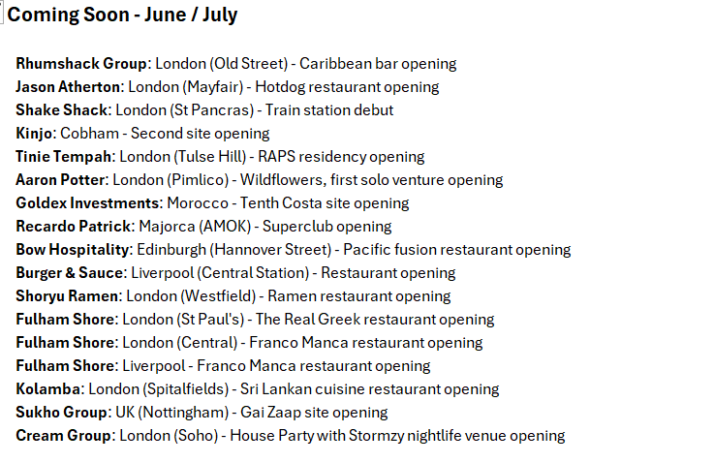
Moonshot Hospitality Industry Updates Bar / Club / Restaurant Openings

Slide 7
Business moves

